Slide 1
Banking Management System
BRANCH – CSE 3 YEAR
RATNESH TRIPATHI
NITESH PRAJPATHI

Slide 2
INTRODUCTION
Bank is the place where customers feel the sense of safety for their property. In the bank, customers deposit and withdraw their money.
Transaction of money also is a part where customer takes shelter of the bank. Now to keep the belief and trust of customers, there is the positive need for management of the bank, which can handle all this with comfort and ease. Smooth and efficient management affects the satisfaction of the customers and staff members, indirectly.
And of course, it encourages management committee in taking some needed decision for future enhancement of the bank. Now a days, managing a bank is tedious job upto certain limit. So a bank management system that reduces the work is essential. Also today’s world is a genuine computer world and is getting faster and faster day-by-day.
Thus, considering above necessities, the system for bank management has became necessary which would be useful in managing the bank more efficiently.

Slide 3
PROBLEM STATEMENT
The Bank Management system consists of the bank administrator and the customer. The administrator will need to create a new account for the customer by logging into their existing account.
For creating a new account on the system the administrator will need to enter details of customer like first name, last name, address, contact no and will add the branch where the account has been created.
The system executes operations like creating new account, checking the balance of the account, withdrawing, depositing, money transfers between two accounts and viewing transaction history.

Slide 4
SYSTEM REQUIREMENTS
FRONT END: JAVA Forms and Swing GUI is utilized to implement the frontend.
BACK END: The back end is implemented by using JDBC which is connected with MYSQL and XAMPP server.

Slide 5
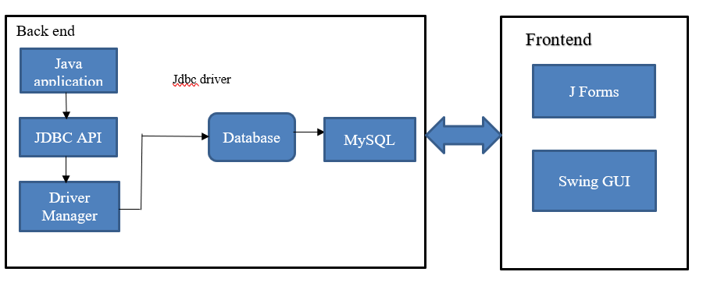
SYSTEM DESIGN

Slide 6
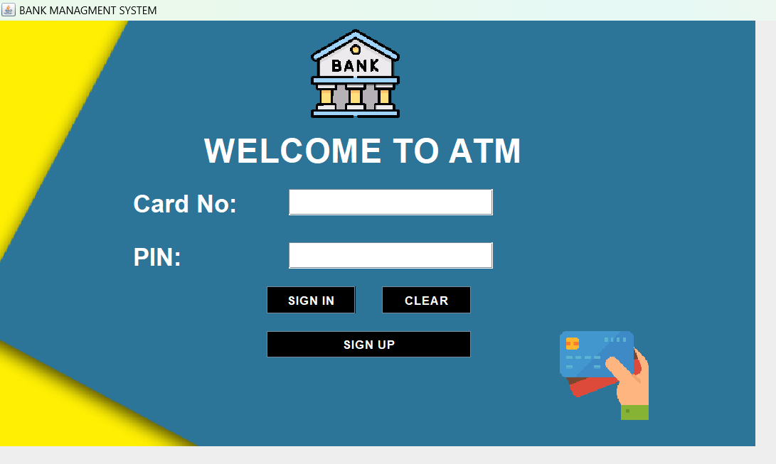
IMAGES

Slide 7
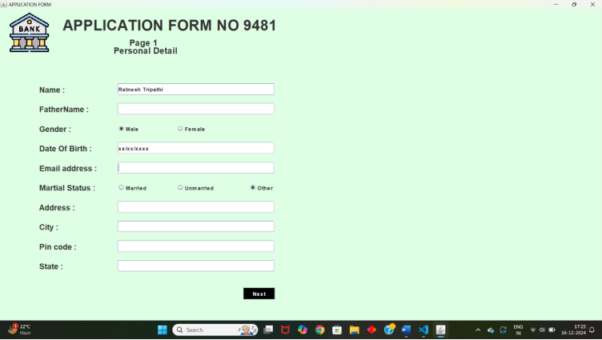
Personal Detail

Slide 8
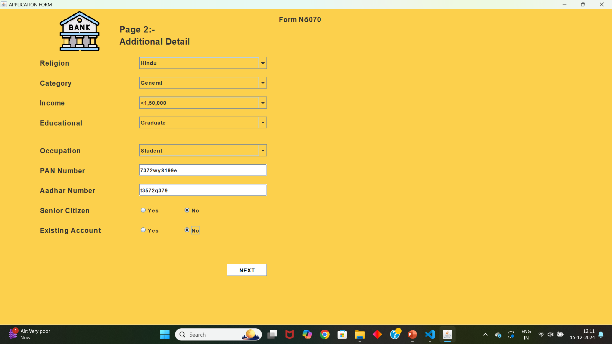
ADDITIONAL DETAIL

Slide 9
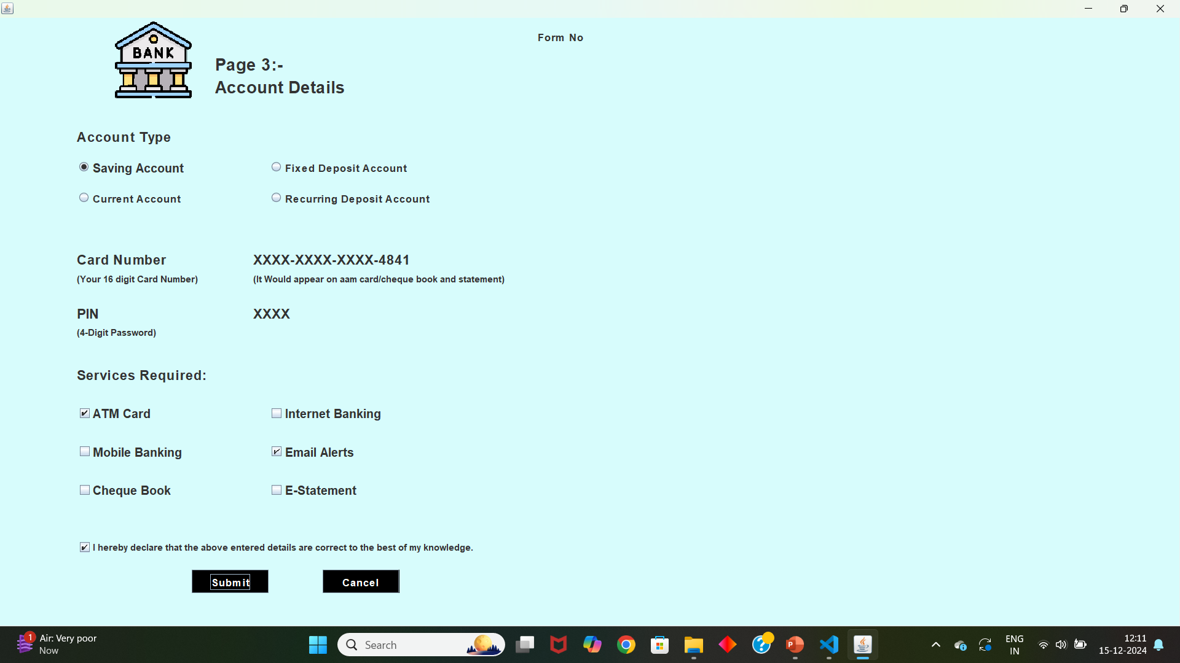
ACCOUNT DETAIL

Slide 10
Database Management System
A Bank Management System database needs to store and manage data about customers, accounts, transactions, employees, loans, and more. The system should maintain relationships between entities and ensure data integrity.
Entities and their Attributes are :
Bank Entity : Attributes of Bank Entity are Bank Name, Code and Address. Code is Primary Key for Bank Entity.
Customer Entity : Attributes of Customer Entity are Customer_id, Name, Phone Number and Address. Customer_id is Primary Key for Customer Entity.
Branch Entity : Attributes of Branch Entity are Branch_id, Name and Address. Branch_id is Primary Key for Branch Entity.
Account Entity : Attributes of Account Entity are Account_number, Account_Type and Balance. Account_number is Primary Key for Account Entity.
Loan Entity : Attributes of Loan Entity are Loan_id, Loan_Type and Amount. Loan_id is Primary Key for Loan Entity.

Slide 11
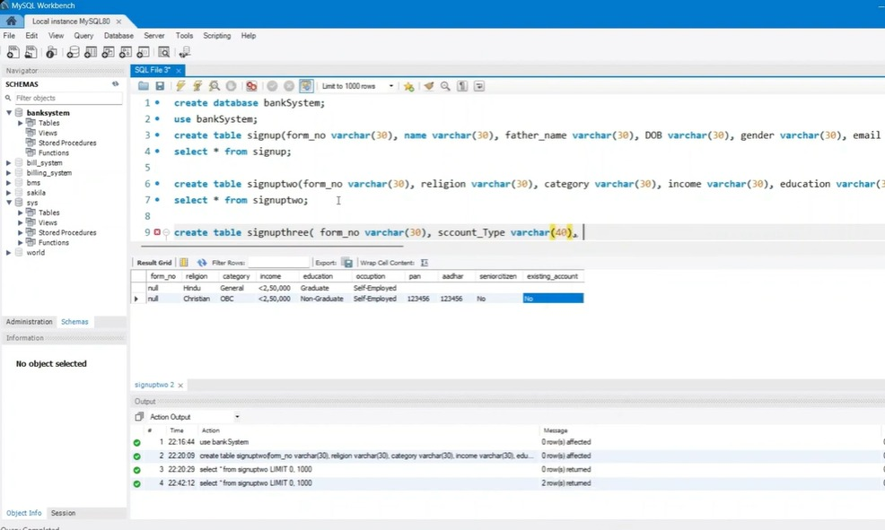
DATABASE

Slide 12
REFERRENCES
https://netbeans.org/kb/index.html
https://www.javatpoint.com/online-banking-project
https://projectsgeek.com/2016/02/complete-banking-system-java-project.html#:~:text=Proposed%20System,valid%20user%20id%20and%20password.
https://www.apachefriends.org/index.html

Slide 13
THE END

